Slide 1

Department of CE
Computer Programming (01CE1101)
Unit- 2
C Programming Basics

Slide 2
What is Programming?
It is a Process to give a step by step instructions to computer to do something(Operations).
C is a general-purpose programming language that is extremely popular, simple, and flexible to use.
It is also a structured programming language that is machine-independent and extensively.
It used to write various applications - Operating Systems like Windows, and complex programs like Oracle database, Git, Python interpreter, Google, Mozilla Firefox, Compilers, Gaming and animation software, etc.

Slide 3
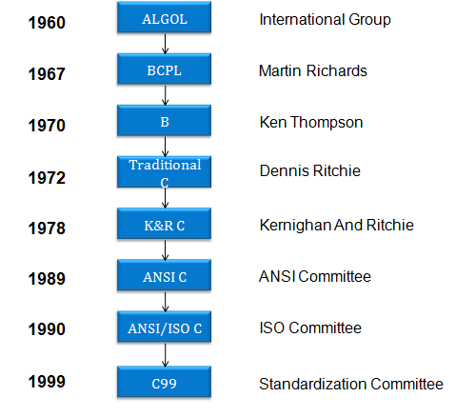
History of C

Slide 4
Advantages of C
Robust Language
Built-in-Functions
Well Structured Programming Language
Combine assembly language with High-Level Language
Efficient and Fast
Highly Portable
Ability to extend

Slide 5
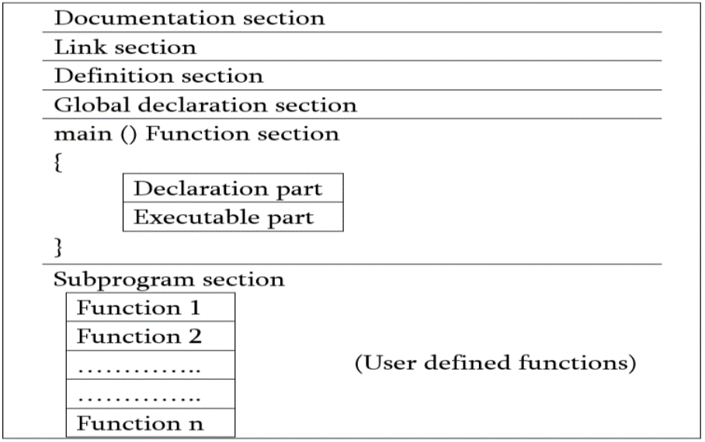
Structure of C Program

Slide 6
Structure of C Program
Documentation section:
The documentation section consists of a set of comment lines giving the name of the program, the author and other details, which the programmer would like to use later.
Link section:
The link section provides instructions to the compiler to link functions from the system library such as using the #include directive.
Definition section:
The definition section defines all symbolic constants such using the #define directive.

Slide 7
Structure of C Program
Global declaration section:
There are some variables that are used in more than one function.
Such variables are called global variables and are declared in the global declaration section that is outside of all the functions. This section also declares all the user-defined functions.

Slide 8
Structure of C Program
main () function section:
Every C program must have one main function section. This section contains two parts;
i)Declaration part: The declaration part declares all the variables used in the executable part.
ii)Executable part: There is at least one statement in the executable part.
These two parts must appear between the opening and closing braces. The program execution begins at the opening brace and ends at the closing brace.
The closing brace of the main function is the logical end of the program.
All statements in the declaration and executable part end with a semicolon.

Slide 9
Structure of C Program
Subprogram section:
If the program is a multi-function program, then the subprogram section contains all the user-defined functions that are called in the main () function.
User-defined functions are generally placed immediately after the main () function, although they may appear in any order.

Slide 10
Simple C Program
Example
/* Description: Writes the words "Hello, World!" on the screen */
#include<stdio.h>
int main()
{
printf("Hello, World!\n");
return 0;
}

Slide 11
Points to remember
#include<stdio.h> - stdio is standard for input/output, this allows us to use some commands which includes a file called stdio.h or
This is a pre - processor command. That notifies the compiler to include the header file stdio.h in the program before compiling the source-code.
Two curly brackets "{...}" are used to group all statements. Curly braces which shows how much the main() function has its scope.
\n – New line character. It indicates the complier to display the output in new line.

Slide 12




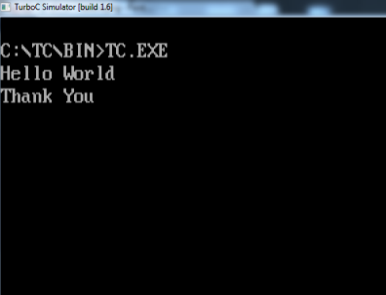
Compilation and Linking processes
Steps of Program Execution
Compiler
C Program
Machine Code
010100011010
101011100000
101010101010
001110101010
Output

Slide 13
Steps of Program Execution
Creating program and save a file
Compiling the program
Linking the program - with functions that are needed from c library.
Executing the program

Slide 14
Example
Output:
#include<stdio.h>
void main()
{
printf(“Hello World..”);
}
Hello World..

Slide 15
Example
#include<stdio.h>
void main()
{
printf(“Hello World..”);
printf(“How are you?”);
}
Output:
Hello World..How are you?

Slide 16
Example
Output:
#include<stdio.h>
void main()
{
printf(“Hello World..”);
printf(“\nHow are you?”);
}
Hello World..
How are you?

Slide 17
printf( ) and its Purpose
C does not contain any instruction to display output on the screen.
All output to screen is achieved using readymade library functions - printf( ).
The general form of printf( ) function is,
To display message
printf ( “Display strings”) ;
To print the value
printf ( "<format string>", <list of variables>) ;

Slide 18
scanf( ) and its Purpose
The scanf() function is used for input. It reads the input data from the console.
scanf("format Specifier”,&Variablename );
Note the use of ampersand (&) before the variables in the scanf( ) function is a must.
scanf(“%d”, &a);
& is an ‘Address of’ operator. It gives the location number (address) used by the variable in memory.
When we say &a, we are telling scanf( ) at which memory location should it store the value supplied by the user from the keyboard.

Slide 19
Format specifiers in C
You need to use format specifiers whether you're printing formatted output with printf() or accepting input with scanf().
The format specifier is used during input and output.
It is a way to tell the compiler what type of data is in a variable during taking input using scanf() or printing using printf(). The following specifiers are used in C.
Character format specifier : %c
For Integer & Signed Integer format specifier : %d, %i
Floating-point format specifier : %f, %e or %E
String printing: %s
Double floating-point number : %lf
Unsigned integer: %u
Long long int: 2.%lld

Slide 20
Comments in a C Program
Comments are used in a C program to clarify either the purpose of the program or the purpose of some statement in the program.
It is a good practice to begin a program with a comment indicating the purpose of the program, its author and the date on which the program was written.
2 comment lines
- Single comment (//)
- Multiple line comment(/*…………*/)

Slide 21
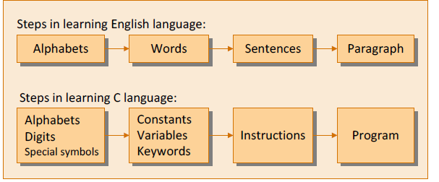
Steps in learning C language

Slide 22
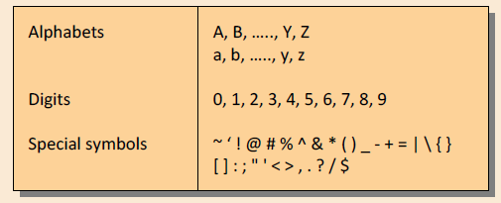
The C Character Set
A character denotes any alphabet, digit or special symbol used to represent information.
Constants, Variables and Keywords
The alphabets, digits and special symbols when properly combined form constants, variables and keywords.

Slide 23
Constants
Constant is a any value that cannot be changed during program execution.
Example:
3.25
“Hello”
‘A’
‘b’
‘R’
-20
98
78.354
“How are you?”

Slide 24
Types of Constants
Integer Constants
Floating-point Constants
Character Constants
String Constants

Slide 25
Integer Constants
It consists a sequence of digits.
Rules for Constructing Integer Constants
(a) An integer constant must have at least one digit.
(b) It must not have a decimal point.
(c) It can be either positive or negative.
(d) If no sign precedes an integer constant, it is assumed to be positive.
(e) No commas or blanks are allowed within an integer constant.
(f) The allowable range for integer constants is
-2147483648 to +2147483647.

Slide 26
Types of Integer constants
Decimal -> 123, -321, 67945, +34
Octal -> 0463, 0, 0551
Hexadecimal -> 0x8F,0x2,0Xbcd

Slide 27
Floating point Constants
Floating Point constants are often called Real constants.
These represent numbers containing fractional parts.
This constants could be written in two forms —
Fractional form
Exponential form
Example: 2.36
-97.2354

Slide 28
Floating point Constants
Following rules must be observed while constructing floating point constants
(a) A real constant must have at least one digit.
(b) It must have a decimal point.
(c) It could be either positive or negative.
(d) Default sign is positive.
(e) No commas or blanks are allowed within a real constant.

Slide 29
Character Constants
These are represent a single character value.
Example: ‘A’ ,’b’, ’@’
Rules for Constructing Character Constants
A character constant is a single alphabet, a single digit or a single special symbol enclosed within single inverted commas.
Both the inverted commas should point to the left. For example, ’A’ is a valid character constant whereas ‘A’ is not.

Slide 30
String Constants
A sequence of characters which are enclosed in double quotes.
Example: “Computer”
“12345”

Slide 31
Variables
It is used to store values in program.
A particular type of variable can hold only the same type of constant.
The value of the variable can be change during the execution.
Example:
X, balance, User_name

Slide 32
Rules for Variables
A variable name is any combination of 1 to 31 alphabets, digits or underscores.
The first character in the variable name must be an alphabet or underscore ( _ ).
No commas or blanks are allowed within a variable name.
No special symbol other than an underscore (as in gross_sal) can be used in a variable name.
Uppercase and lowercase are significant(different).

Slide 33
Variables and their Usage
Any variable used in the program must be declared before using it.
For example,
int p, n ; //declaration
float r, si ; //declaration
si = p * n * r / 100 ; //usage

Slide 34
Variable Declaration
how you can create or declare a new variable in the C language,
data_type var_name;
(or)
data_type var_name1,var_name2…,var_name n ;
where, data_type is a valid data type (along with datatype modifiers, if required) and var_name is the name of the variable.
Example
int marks;
int enroll,contact_no;

Slide 35
Variable definition
Once we have declared or created the variable, then we can assign a value to it. This is called variable definition.
// variable declaration
int marks;
// variable definition or variable Initialization
int marks = 10;
int i=0;

Slide 36
Types of Variables
There are types of variables in c:
Local variable
Global variable
Static variable

Slide 37
Static Variable
A variable that is declared with the static keyword is called static variable.
It retains its value between multiple function calls.
void function1()
{
int x=10;//local variable
static int y=10;//static variable
x=x+1;
y=y+1;
printf("%d,%d",x,y);
}

Slide 38
Local variable
A variable that is declared inside the function or block is called a local variable.
It must be declared at the start of the block.
void function1()
{
int x=10;//local variable
}
You must have to initialize the local variable before it is used.

Slide 39
Global variable
A variable that is declared outside the function or block is called a global variable. Any function can change the value of the global variable. It is available to all the functions.
It must be declared at the start of the block.
int value=20;//global variable
void function1()
{
int x=10;//local variable
}

Slide 40
C Keywords
All keywords are predefined, reserved words.
Its having fixed meanings and meanings cannot be changed .
The keywords cannot be used as variable names.
There are 32 keywords available in C.

Slide 41
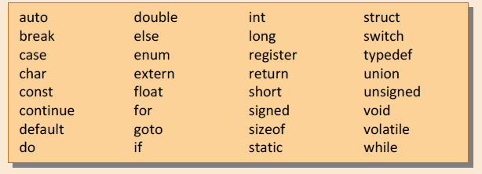
C Keywords

Slide 42
Data types
A data type is a classification of data which tells the compiler or interpreter how the programmer intends to use the data.
The type of a variable determines how much space it occupies in storage and how the bit pattern stored is interpreted.
Once we define a variable with some datatype then we cannot change the datatype of that variable.

Slide 43
Data types
Types | Data Types
Primary(fundamental) Data Type | int, char, float, double
Derived Data Type | array, pointer
User defined Data Type | enum, structure, union
Void Data Type | void

Slide 44
Data types
C language supports 4 fundamental data types
Type | Purpose | Size (Bytes) | Range of values
int | For storing integers | 2 or 4 | -32768 to 32767 (for 2 bytes)
float | For storing real numbers | 4 | 3.4e-38 to 3.4e+38
double | For storing double precision floating | 8 | 1.7e-308 to 1.7e+308
char | for storing characters | 1 | -128 to 127

Slide 45
Data types
Some other data types :
Type | Size (Bytes) | Range of values
short | 2 | -32768 to 32767
long | 4 | -2147483948 to 2147483947
unsigned char | 1 | 0 to 255
unsigned int | 2 | 0 to 65535
unsigned long | 4 | 0 to 4294967295

Slide 46
C Tokens
C Tokens are the smallest building block or smallest unit of a C program.
The compiler breaks a program into the smallest possible units and proceeds to the various stages of the compilation, which is called token.

Slide 47
Tokens Example
#include<stdio.h>
void main()
{
printf (“Hello World”) ;
}

Slide 48
C Tokens
C Tokens
Keywords
Constants
Strings
Operators
float
while
-15.5
100
“ABC”
“year”
+ -
= %
Identifiers
Special Symbols
main
amount
x
[ ]
{ }
( )

Slide 49
Identifiers
Identifiers refers to the names of variables, functions, and arrays.
User defined names and consists of a sequence of letters and digits, with a letter as first character.
Ex:
int money;
double accountBalance;

Slide 50
Rules for defining identifiers
First character must be an alphabet (or underscore).
Must contain only letters, digits or underscore.
Only first 32 characters are significant.
Cannot use a special keyword.
Must not contain white space.

Slide 51
Operators in C
Operators as symbols that help us to perform specific mathematical and logical computations on operands.
Arithmetic Operators
Relational operators
Logical operators
Assignment operator
Increment and decrement operators
Bitwise operator
Conditional operators
Special operators

Slide 52
Arithmetic Operators
These are the operators used to perform arithmetic/mathematical operations on operands. Examples: (+, -, *, /, %).
An operand is a term used to describe any object that is capable of being manipulated.
Arithmetic operator are of two types:
Unary Operators: Operators that operates or works with a single operand are unary operators. For example: (+ , –)
Binary Operators: Operators that operates or works with two operands are binary operators. For example: (+ , – , * , /)

Slide 53
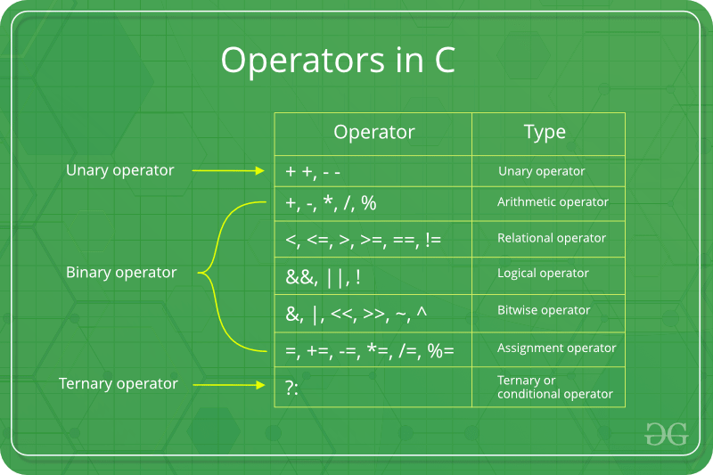
Arithmetic Operators

Slide 54
Relational Operators
These are used for comparison of the values of two operands.
For example, checking if one operand is equal to the other operand or not, an operand is greater than the other operand or not etc.
Equal to operator ==
Not equal to operator !=
Greater than operator >
Less than operator <
Greater than or equal to operator >=
Less than or equal to operator <=

Slide 55
Logical operators
Logical Operators are used to combine two or more conditions/constraints or to complement the evaluation of the original condition in consideration.
The result of the operation of a logical operator is a boolean value either true or false.
Logical AND operator: The ‘&&’ operator returns true when both the conditions under consideration are satisfied. Otherwise it returns false. For example, a && b returns true when both a and b are true (i.e. non-zero).

Slide 56
Logical operators
Logical OR operator: The ‘||’ operator returns true even if one (or both) of the conditions under consideration is satisfied. Otherwise it returns false. For example, a || b returns true if one of a or b or both are true (i.e. non-zero). Of course, it returns true when both a and b are true.
Logical NOT operator: The ‘!’ operator returns true the condition in consideration is not satisfied. Otherwise it returns false. For example, !a returns true if a is false, i.e. when a=0.

Slide 57
Assignment operators
Assignment operators are used to assign value to a variable.
The left side operand of the assignment operator is a variable and right side operand of the assignment operator is a value.
The value on the right side must be of the same data-type of variable on the left side otherwise the compiler will raise an error.

Slide 58
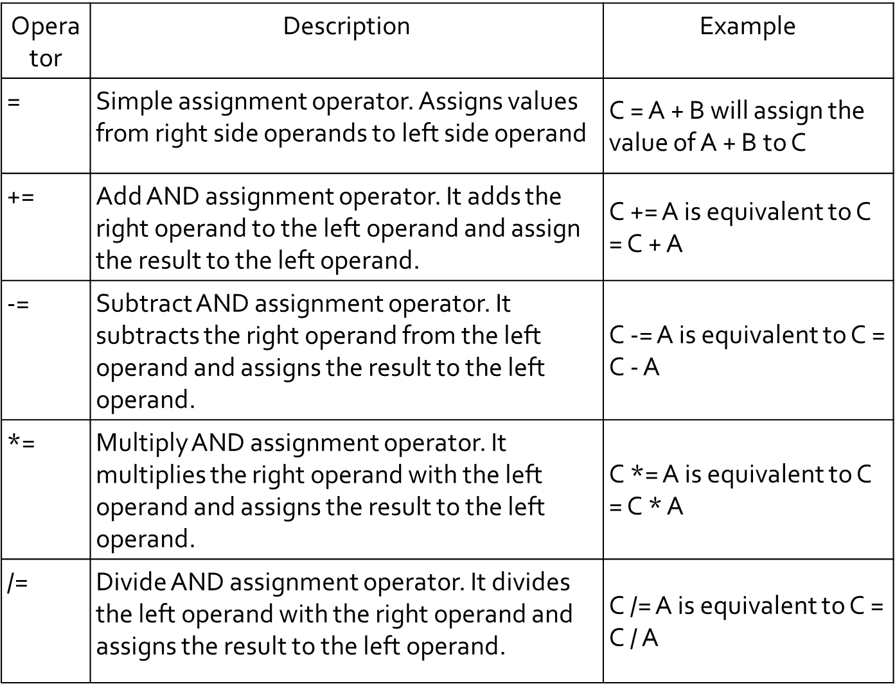
Assignment operators

Slide 59
Increment and decrement operators
Increment and decrement operators are
Increment ++
decrement - -
Both are used to change the value of an operand (constant or variable) by 1.
Increment ++ increases the value by 1.
decrement -- decreases the value by 1.
These two operators are unary operators, meaning they only operate on a single operand.

Slide 60
Bitwise Operators
The Bitwise operators is used to perform bit-level operations on the operands.
The operators are first converted to bit-level and then the calculation is performed on the operands.
The mathematical operations such as addition, subtraction, multiplication etc. can be performed at bit-level for faster processing.

Slide 61
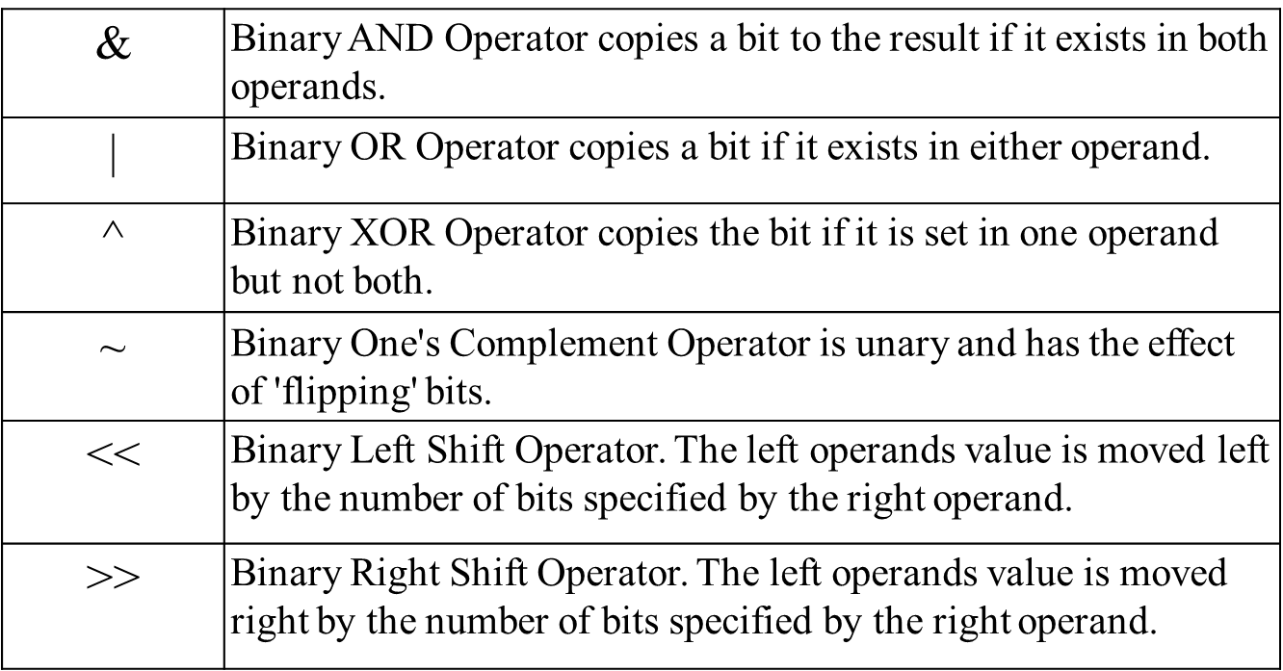
Bitwise Operators

Slide 62
Conditional operator
The conditional operator in C is also called the ternary operator because it operates on three operands.
The operands may be an expression, constants or variables. It starts with a condition, hence it is called a conditional operator.
Syntax:
expression1 ? expression2 : expression3;
or
condition ? true statement : false statement;
Example:
a=10; b=15;
X=(a>b)?a : b;

Slide 63
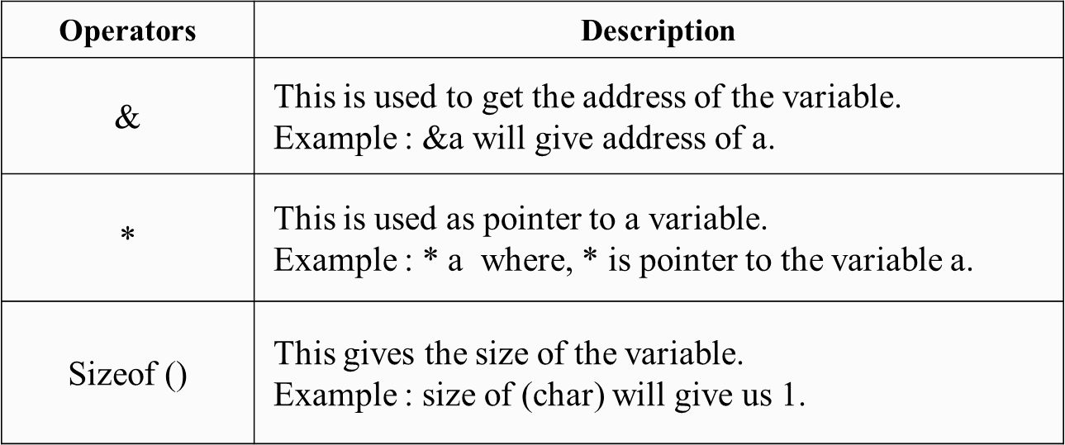
Special Operators

Slide 64
Operator Precedence and Associativity
Operator precedence determines the grouping of terms in an expression and decides how an expression is evaluated.
Certain operators have higher precedence than others.
For example, the multiplication operator has a higher precedence than the addition operator.
For example: Solve
10 + 20 * 30
10 + 20 * 30 is calculated as 10 + (20 * 30)
and not as (10 + 20) * 30

Slide 65
Operator Precedence and Associativity
Operators Associativity is used when two operators of same precedence appear in an expression. Associativity can be either Left to Right or Right to Left.
Operators with the highest precedence appear at the top of the table, those with the lowest appear at the bottom. Within an expression, higher precedence operators will be evaluated first.
For example:
‘*’ and ‘/’ have same precedence and their associativity is Left to Right, so the expression “100 / 10 * 10” is treated as “(100 / 10) * 10”.

Slide 66
Operator Precedence
Category | Operator | Associativity
Postfix | () [] -> . ++ - - | Left to right
Unary | + - ! ~ ++ - - (type)* & sizeof | Right to left
Multiplicative | * / % | Left to right
Additive | + - | Left to right
Shift | << >> | Left to right
Relational | < <= > >= | Left to right
Equality | == != | Left to right
Bitwise AND | & | Left to right
Bitwise XOR | ^ | Left to right
Bitwise OR | | | Left to right
Logical AND | && | Left to right
Logical OR | || | Left to right
Conditional | ?: | Right to left
Assignment | = += -= *= /= %=>>= <<= &= ^= |= | Right to left
Comma | , | Left to right

Slide 67
Type Conversion and Type Casting
Type conversion : In type conversion, a data type is automatically converted into another data type by a compiler at the compiler time. In type conversion, the destination data type cannot be smaller than the source data type, that’s why it is also called widening conversion. One more important thing is that it can only be applied to compatible data types.
Type Conversion example
int x=30;
float y;
y=x; // y==30.000000.

Slide 68
Type Casting - Example
#include <stdio.h>
int main ()
{
float x;
x = (float) 7/5;
printf(“%f”,x);
}

Slide 69
Type Conversion and Type Casting
Type Casting
In typing casting, a data type is converted into another data type by the programmer using the casting operator during the program design.
The destination data type may be smaller than the source data type when converting the data type to another data type, that’s why it is also called narrowing conversion.
Syntax/Declaration:-
destination_datatype = (target_datatype)variable;
where
- (): is a casting operator.
- target_datatype: is a data type in which we want to
convert the source data type.

Slide 70
Type Casting – Types
Converting an expression of a given type into another type is known as type casting. typecasting is more use in c language programming. Here, It is best practice to convert lower data type to higher data type to avoid data loss.
Data will be truncated when the higher data type is converted to lower. For example, if a float is converted to int, data which is present after the decimal point will be lost.
There are two types of type casting in c language.
Implicit Conversion
Explicit Conversion

Slide 71
Type Casting – Types
IMPLICIT CONVERSION
Implicit conversions do not require any operator for converted. They are automatically performed when a value is copied to a compatible type in the program. Here, the value of a has been promoted from int to double and we have not had to specify any type-casting operator. This is known as a standard conversion.
Example :
#include<stdio.h>
#include<conio.h>
void main()
{
int i=20;
double p;
clrscr();
p=i; // implicit conversion
printf(“implicit value is %d”,p);
getch();
}

Slide 72
Type Casting – Types
EXPLICIT CONVERSION
In C language, Many conversions, especially those that imply a different interpretation of the value, require an explicit conversion. We have already seen two notations for explicit type conversion.
Ex:
#include<stdio.h>
#include<conio.h>
void main()
{
int i=20;
short p;
clrscr();
p = (short) i; // Explicit conversion
printf(“Explicit value is %d”,p);
getch();
}

Slide 73
Type Conversion and Type Casting
S.No | TYPE CASTING | TYPE CONVERSION
1. | In type casting, a data type is converted into another data type by a programmer using casting operator. | Whereas in type conversion, a data type is converted into another data type by a compiler.
2. | Type casting can be applied to compatible data types as well as incompatible data types. | Whereas type conversion can only be applied to compatible datatypes.
3. | In type casting, casting operator is needed in order to cast the a data type to another data type. | Whereas in type conversion, there is no need for a casting operator.
4. | In typing casting, the destination data type may be smaller than the source data type, when converting the data type to another data type. | Whereas in type conversion, the destination data type can’t be smaller than source data type.

Slide 74
Type Conversion and Type Casting
S.NO | TYPE CASTING | TYPE CONVERSION
5. | Type casting takes place during the program design by programmer. | Whereas type conversion is done at the compile time.
6. | Type casting is also called narrowing conversion because in this, the destination data type may be smaller than the source data type. | Whereas type conversion is also called widening conversion because in this, the destination data type can not be smaller than the source data type.
7. | Type casting is more efficient and reliable. | Whereas type conversion is less efficient and less reliable.

Slide 75
Thank You!!

